Slide 1
Conceptual ER Diagram
Food Express
FoodRetailerID
FoodItemID
FoodRetailerName
Receives
DistributorID
Food Retailer
OrderID
Email
Email
Phone
Address
UserID
Distributor
Phone
Distributor Number
Address
State
FirstName
Receives
ValidMM/YYYY
Amount
PaymentID
OrderID
ZipCode
LastName
OrderID
ApplePayID
Has
User
Payment
NameOnCard
place
CardNumber
Has
Has
FoodItemID
FoodItems
Add
Order
Security Code
FoodItemName
Quantity
Food RetailerID
category
Cart
OrderDate
OrderID
FoodRetailerID
FoodItemCost
UserID
CartId
FoodItemID
UserID

Slide 2
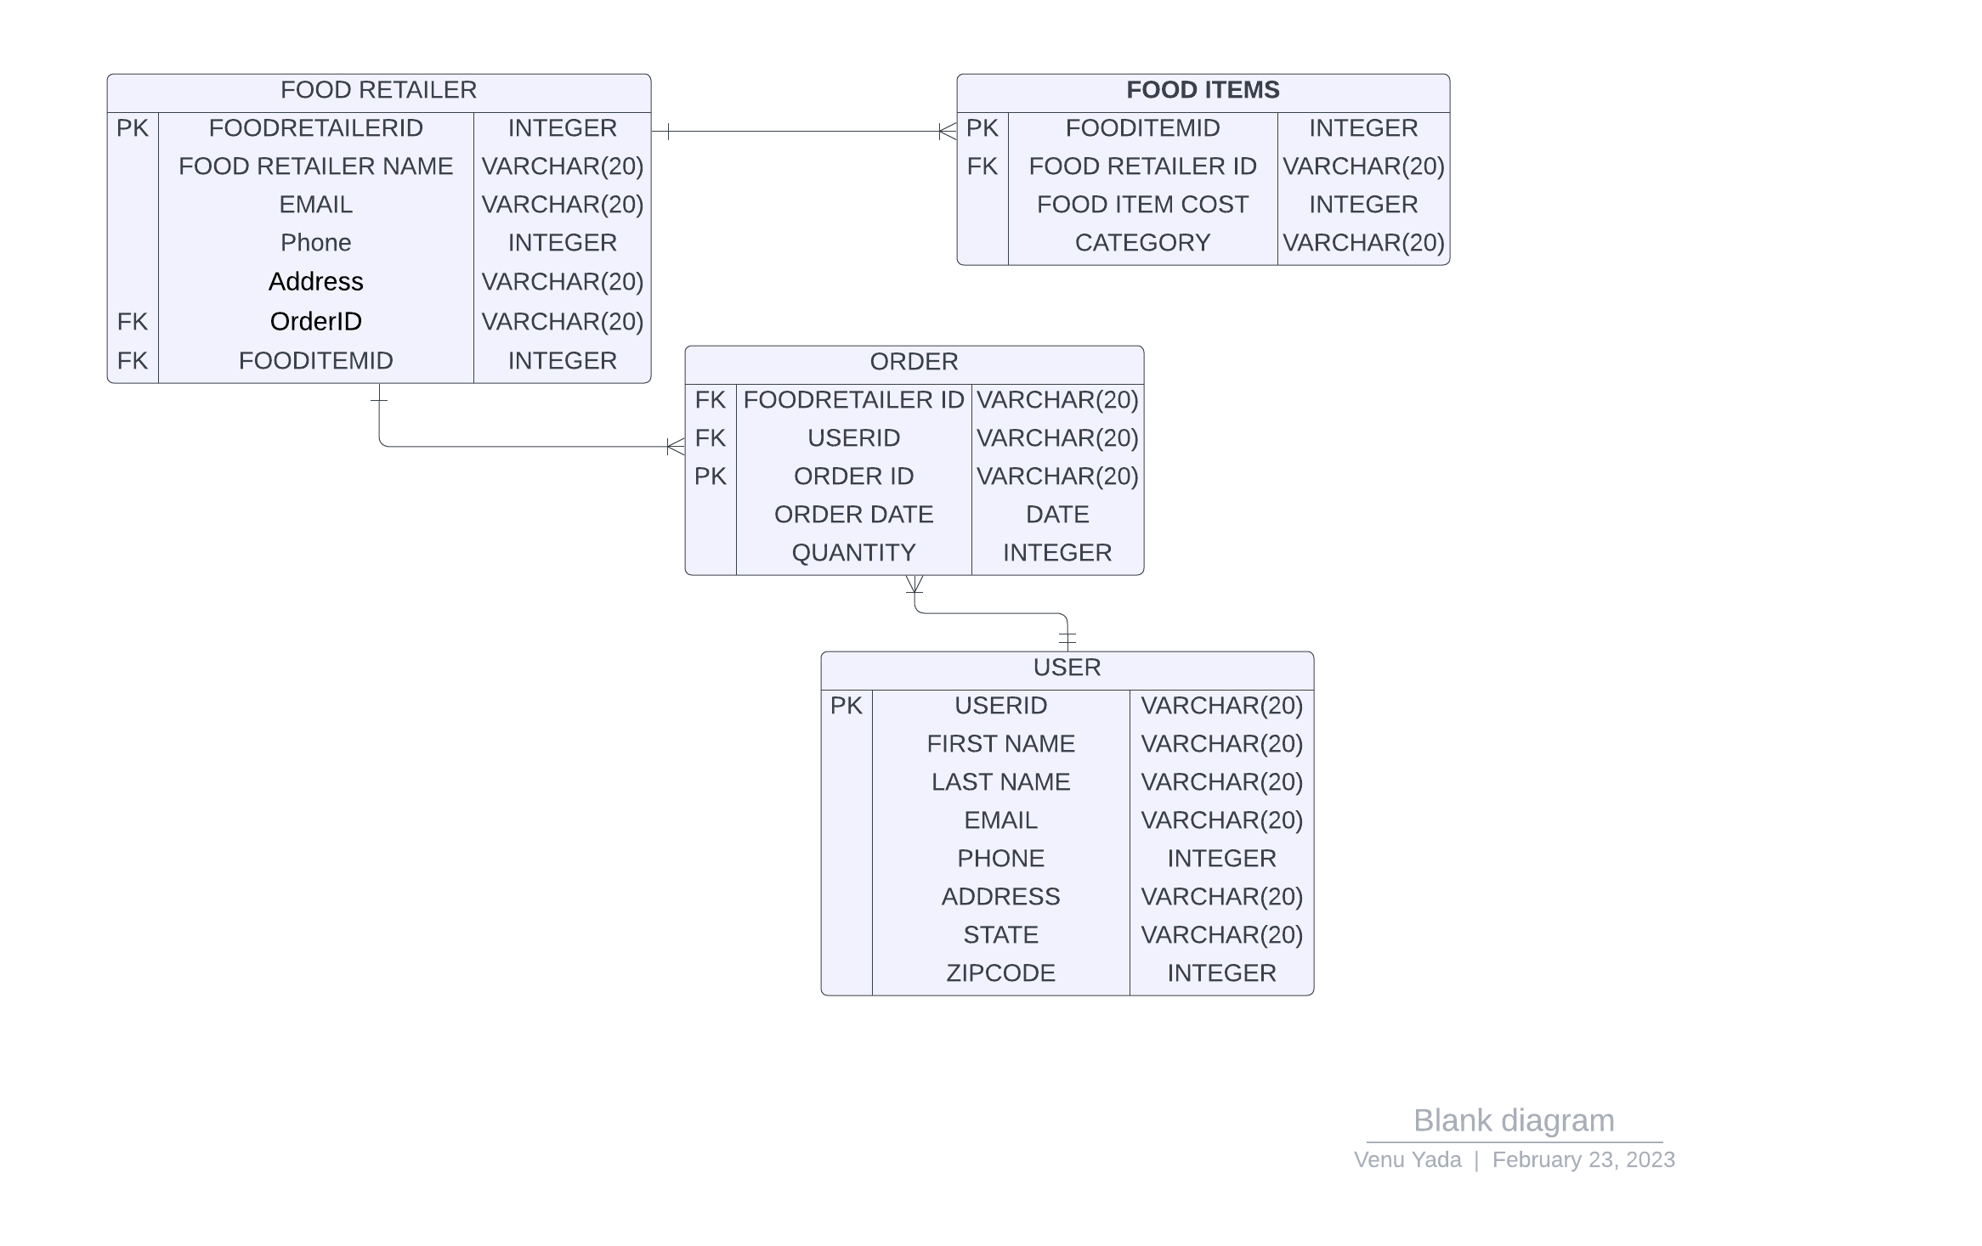
Logical ER Diagram – Iteration 1
Food Express

Slide 3
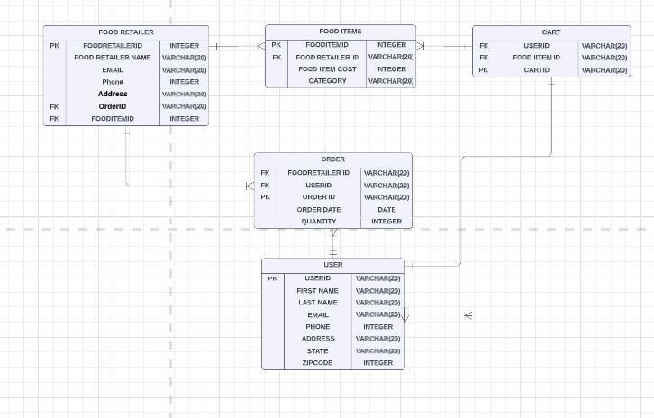
Logical ER Diagram – Iteration 2 Food Express

